Slide 1
Soccer Player Market Value Prediction
Introduction to Machine Learning

Slide 2
Agenda
1
1
Problem Statement
2
Introduction to the Dataset
3
Preliminary Analysis
4
Data Cleaning and Set up
5
Predictions
6
Result and Conclusion

Slide 3






Problem Statement
2
Using machine learning to estimate the market value of football players serves multiple purposes and offers numerous benefits to various stakeholders within the football industry
Global Soccer Industry Worth
Average Transfer
Fee in Europe
> 50 Players
Transfer Value
$28 Billion
$60-65
Million
$100+
Million
Player Evaluations
Transfer Market Efficiency
Risk
Assessment
Player Development
Player Negotiations
Fantasy Sports and Betting
1. Citation Link
2. Citation Link
3. Citation Link

Slide 4

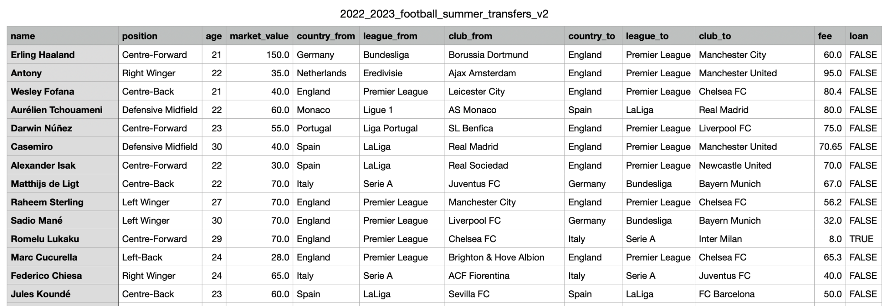
Introduction to the Dataset
3
A glimpse into our initial dataset
2000 data points
12 Identifiers
60 countries
77 leagues
$5.3 million avg market value
25.1 average age of players
Link to the Dataset

Slide 5
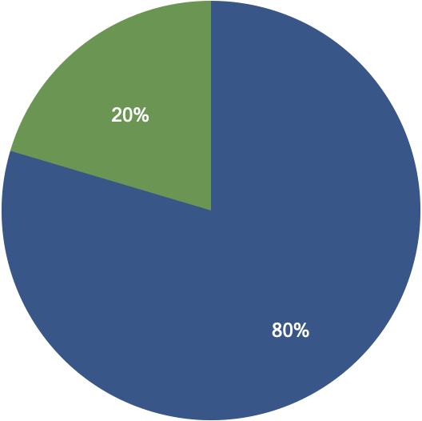
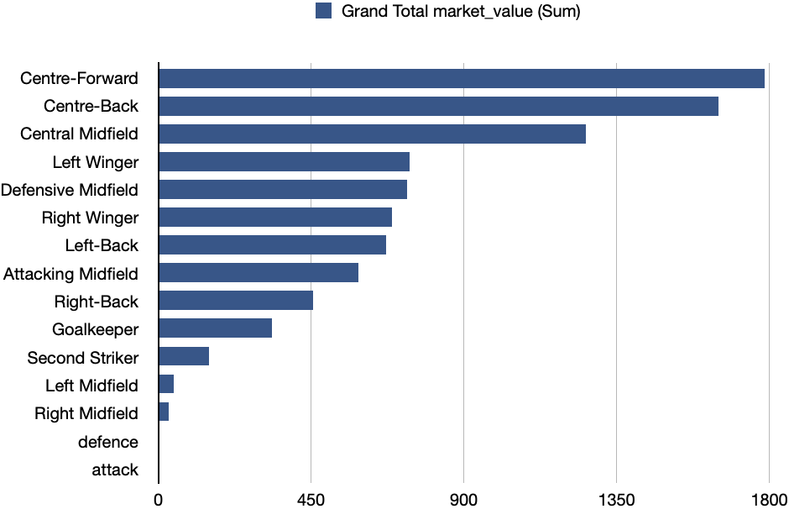
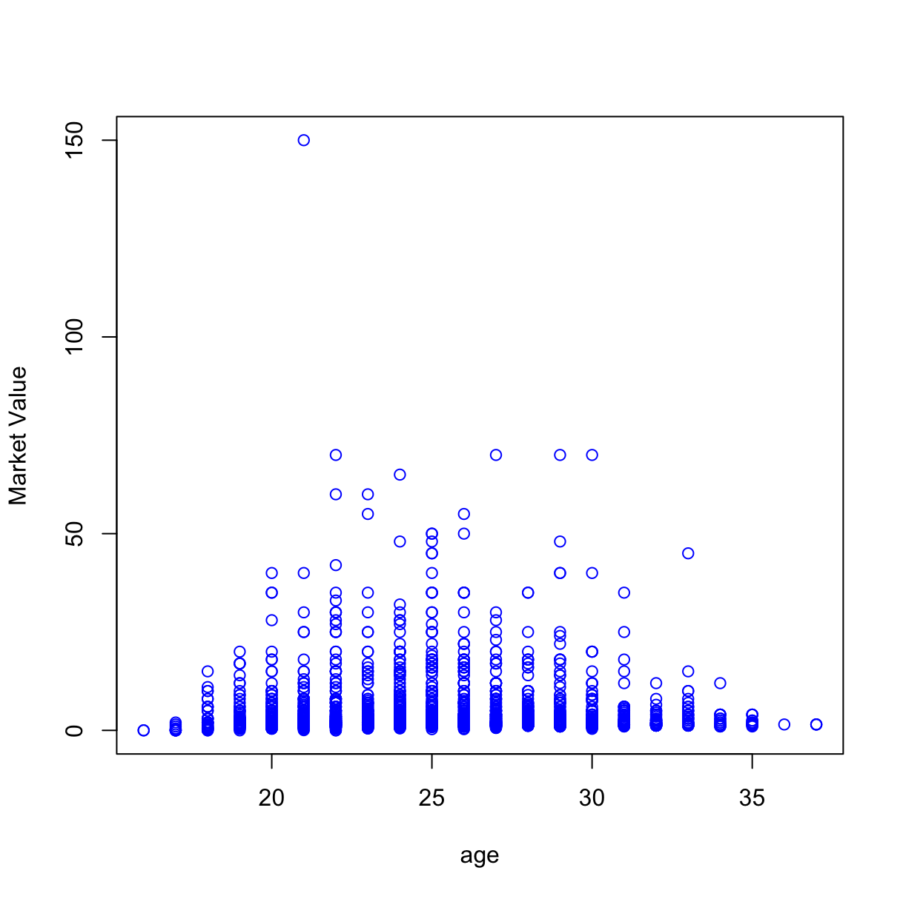
Preliminary Analysis
4
Total Transfer fees involved $5857.324 Million
Direct Co-relationship between Age and Market Value
Others
England, Italy, France, Spain, Germany,
Portugal, Netherlands, Turkey & Brazil
150
Market Value
Dropped 51 Other Countries from dataset
Dropped positions less than 150 from dataset

Slide 6
Data Cleaning and Set up - Initial
5
Dropping of columns not having significant relationship
2000 Rows
12 Columns
650 Rows
70 Columns
Initial Dataset
Checking and Removal of NA Values
One Hot Encoding to use Regression Models
Final Dataset
Dropping of rows which have lower values

Slide 7
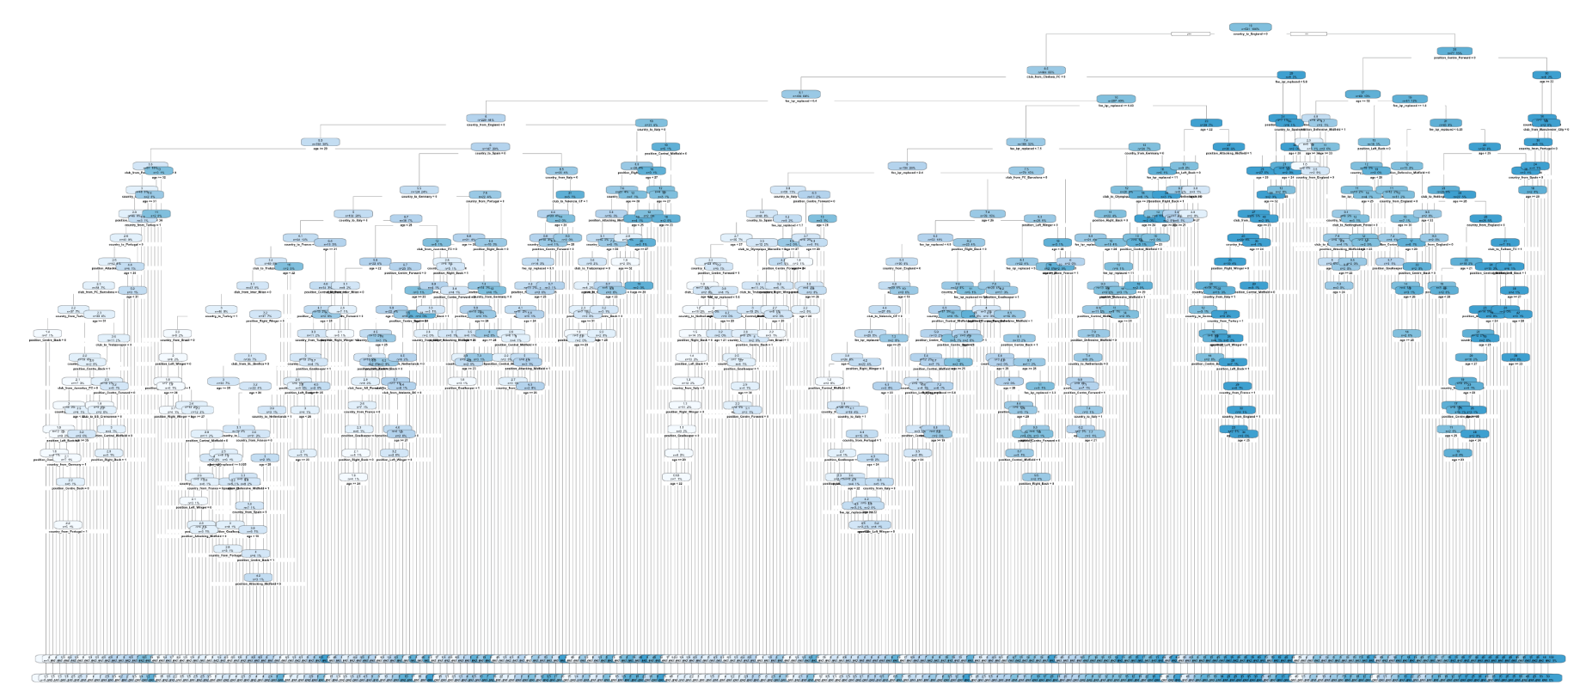
Predictions - Regression Tree
6
Biggest Regression Tree With Labels

Slide 8
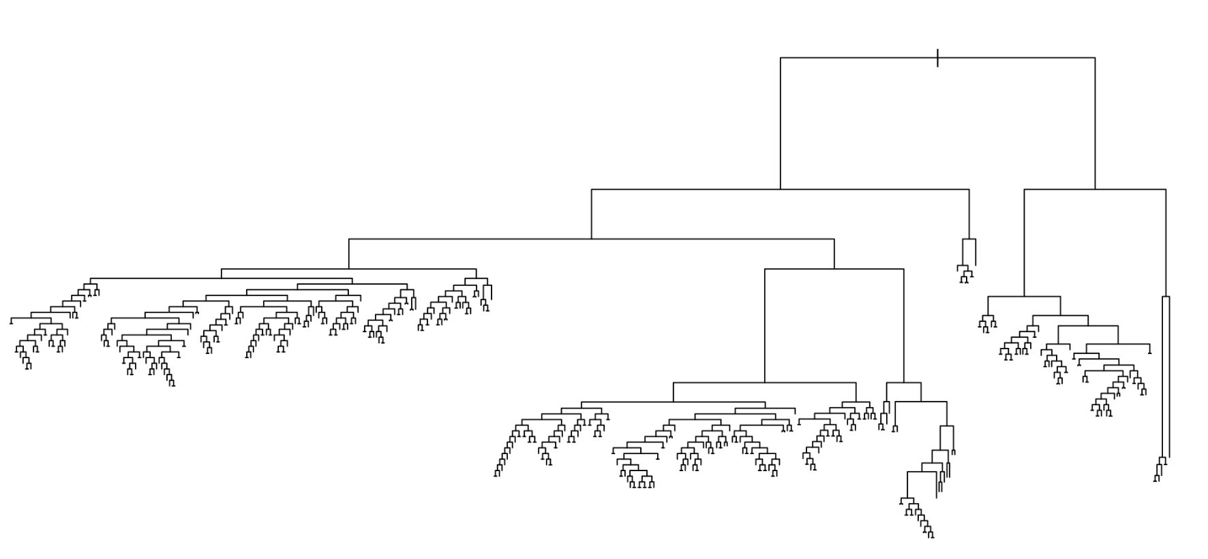
Predictions - Regression Tree
7
Largest Regression Tree Without Labels
1
Tree Size
444 Nodes
2
OOS- MSE
152.1856
3
OOS - RMSE
12.33635

Slide 9
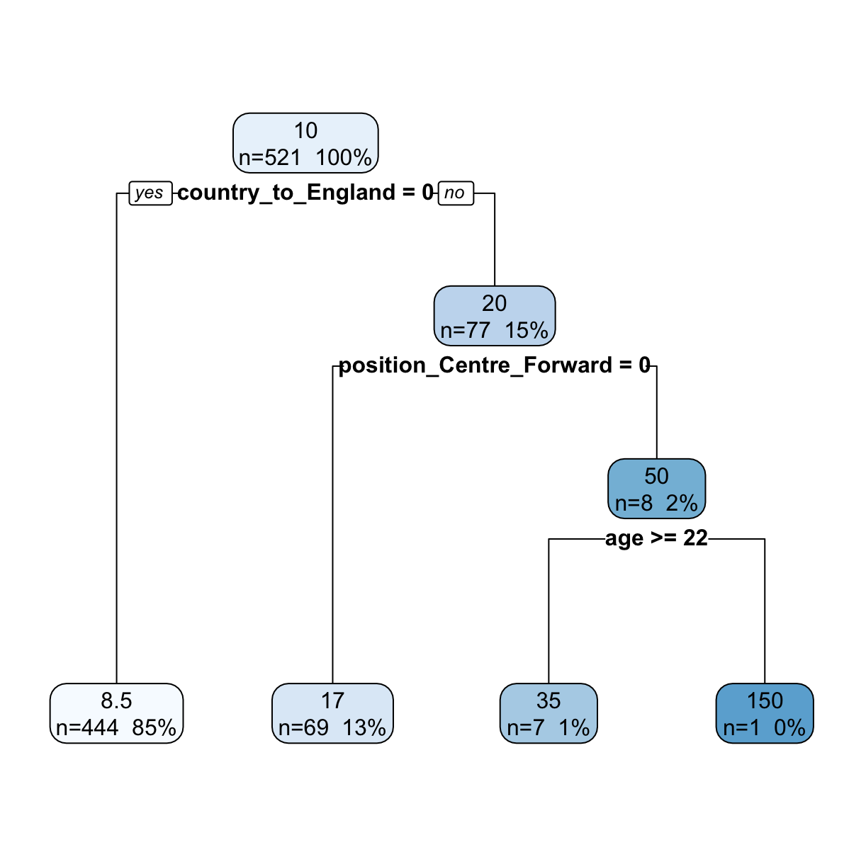
Predictions - Regression Tree After Pruning
8
OOS Indicates: Out of Sample
Pruned Regression Tree before Cross Validation
Pruned Regression Tree without Labels
1
Tree Size
4 Nodes
2
OOS - MSE
123.7179
3
OOS - RMSE
11.12286
Parameters: 0.009 cp value

Slide 10
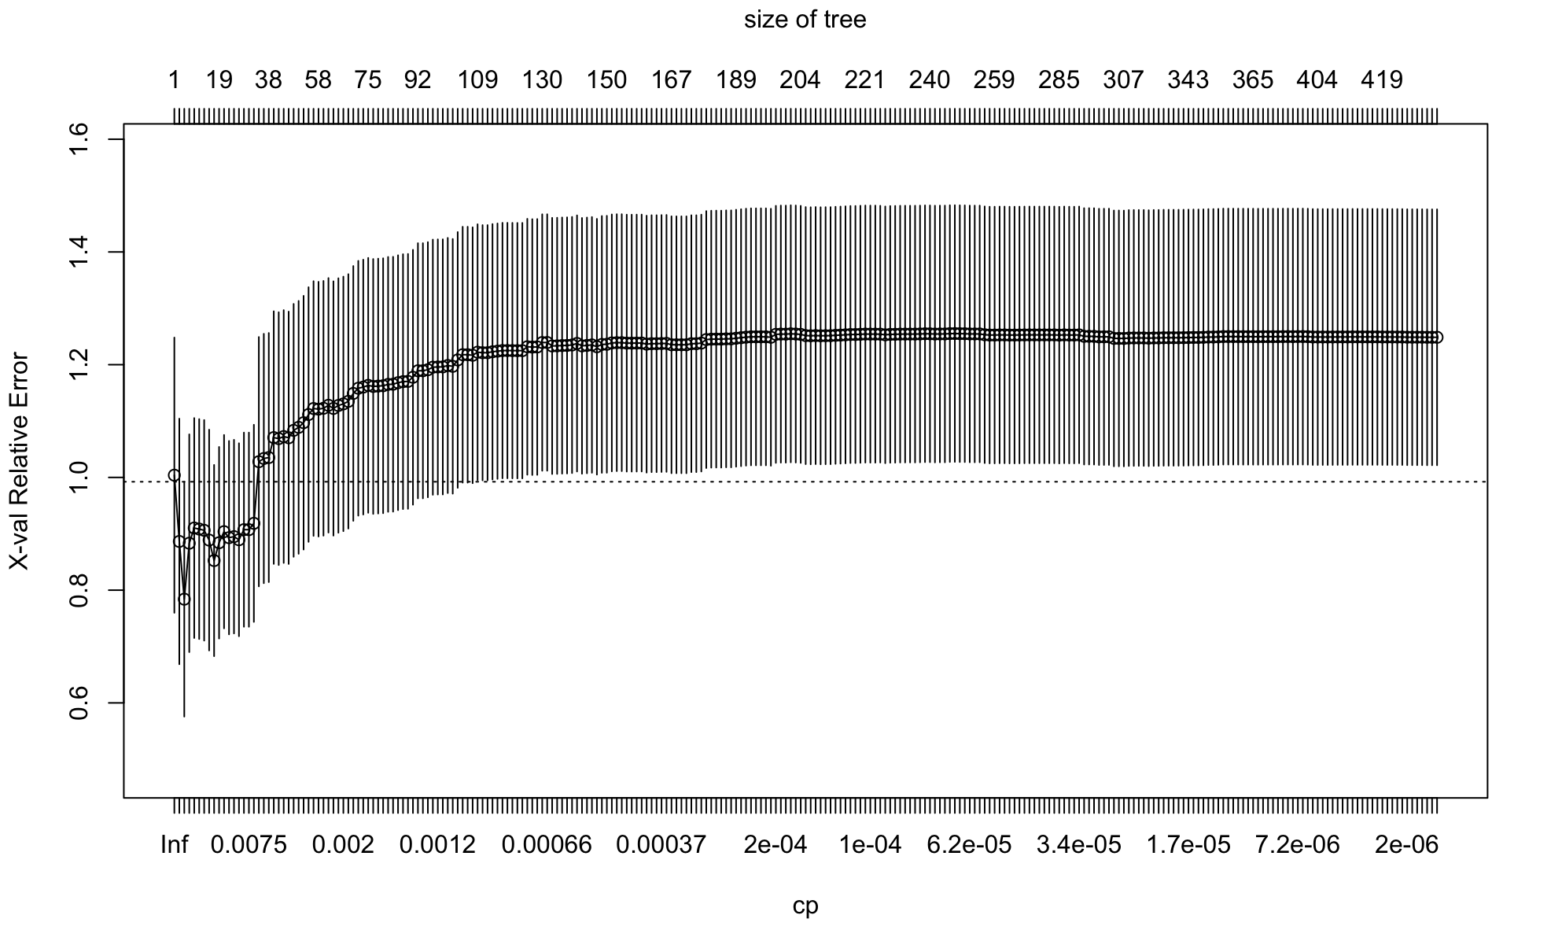
Cross Validation
9
Best Cp Value = 0.02164429

Slide 11
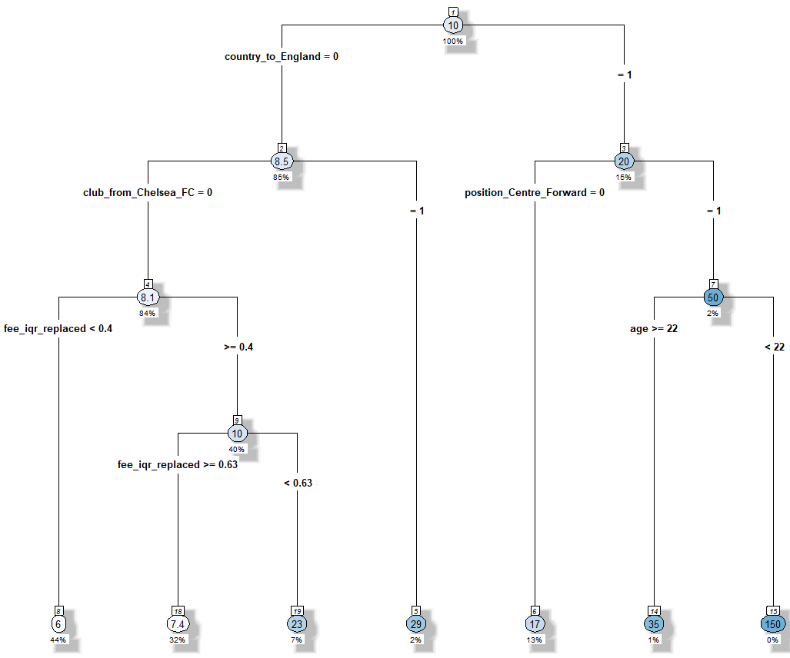
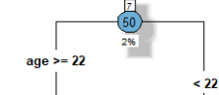
Predictions - Pruned Regression Tree with CV
10
Mean of bucket
% of total data
Pruned Best Regression Tree After Cross Validation
Decision made to split tree
1
Tree Size
7 Nodes
2
OOS MSE
101.2218
3
OOS RMSE
10.06091

Slide 12
Code
1. KNN
X_all = df_2[, names(df_2) != 'market_value']
y_all = df_2[, names(df_2) == 'market_value']
2. Standardize Data
X_all_scaled = scale(X_all)
3. Do Train/Test Split
X_train = X_all_scaled[sample,]
X_test = X_all_scaled[!sample,]
y_train = y_all[sample]
y_test = y_all[!sample]
4. Parameters
set.seed(400)
ctrl <- trainControl(method="cv",number = 5)
knnFit <- train(market_value ~ .,
data = train_data,
method = "knn",
trControl = ctrl,
preProcess = c("scale"),
tuneLength = 20)
Data Cleaning and Set up - KNN (Training)
11
Training KNN Output
# k RMSE Rsquared MAE
# 5 11.02139 0.1213757 7.228084
# 7 10.47570 0.1779024 6.931594
# 9 10.52531 0.1668682 7.031662
# 11 10.51140 0.1661701 7.027533
# 13 10.40963 0.1820090 7.024860
# 15 10.48912 0.1696352 7.154726
# 17 10.51347 0.1667135 7.194237
# 19 10.52206 0.1680179 7.257687
# 21 10.61065 0.1557454 7.395629
# 23 10.64166 0.1553838 7.478454
# 25 10.69690 0.1492581 7.581914
# 27 10.68240 0.1538362 7.607690
# 29 10.70240 0.1537275 7.631921
# 31 10.69231 0.1560763 7.633879
# 33 10.71964 0.1538163 7.694659
# 35 10.73409 0.1524940 7.722722
# 37 10.74685 0.1528922 7.749292
# 39 10.75891 0.1530485 7.757703
# 41 10.76893 0.1534126 7.800876
# 43 10.79759 0.1501754 7.837957
Best K = 13

Slide 13
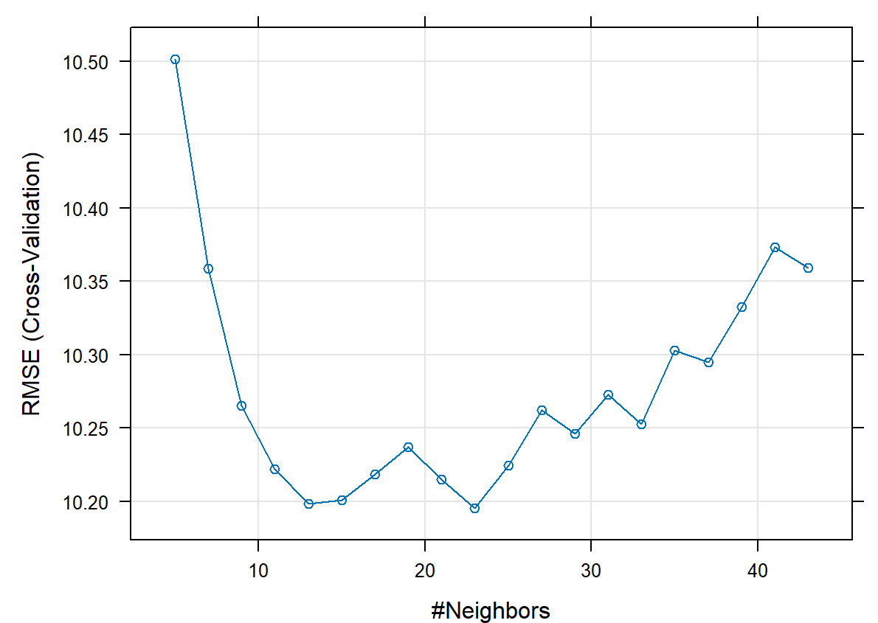
Predictions - KNN
12
RMSE vs Neighbors Graph
1
Best K Value
K = 13
2
OOS MSE
554.196
3
OOS RMSE
23.54137

Slide 14
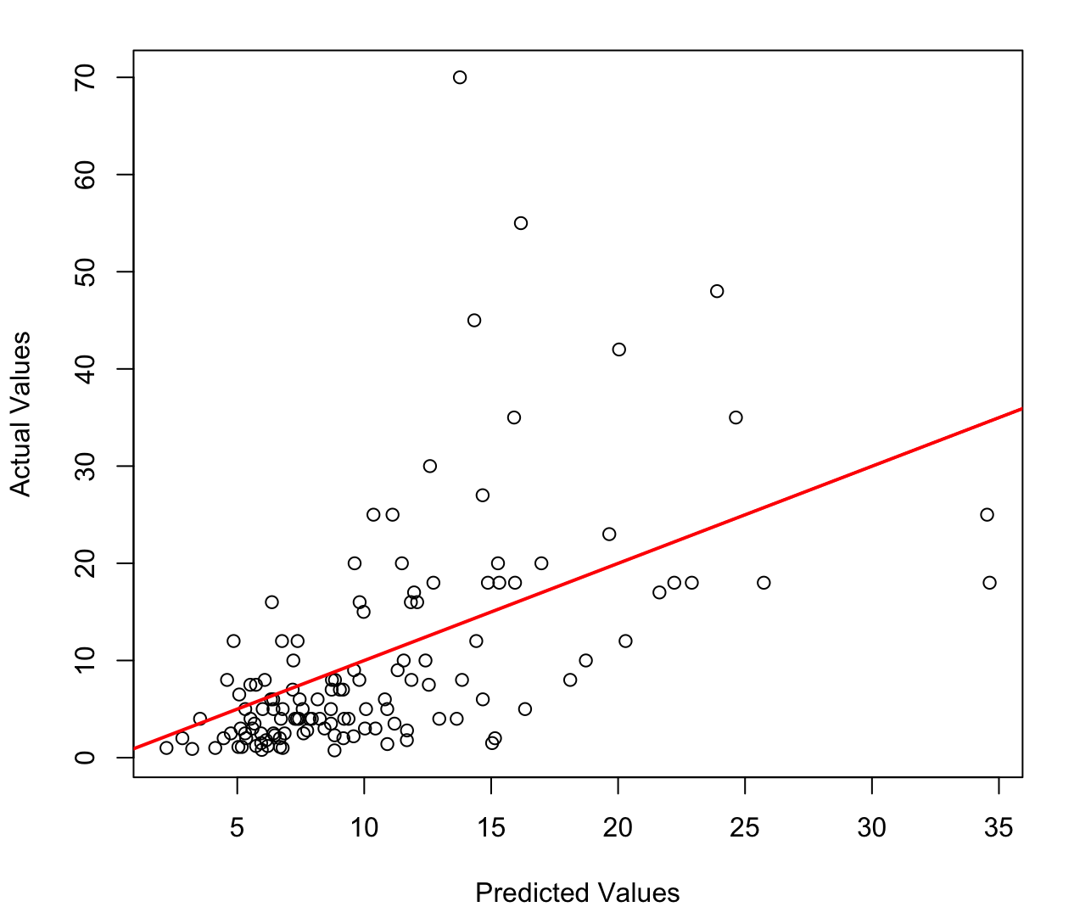
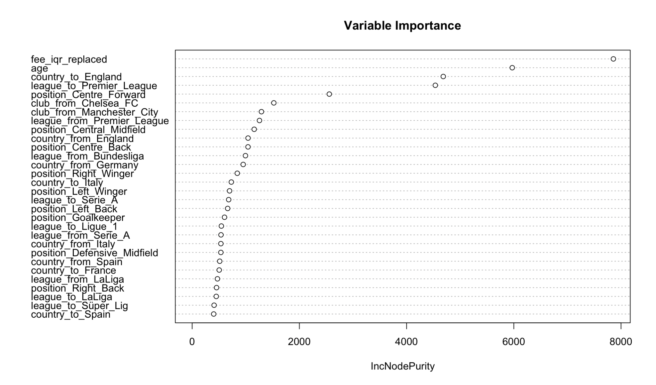
Predictions - Random Forest
14
Actual Value vs Predicted Value Plot
Variable Importance for Random Forest
1
OOS MSE
102.6561
2
OOS RMSE
10.13193
Parameters for Random Forest : 2000 trees | 300 Max Nodes |

Slide 15
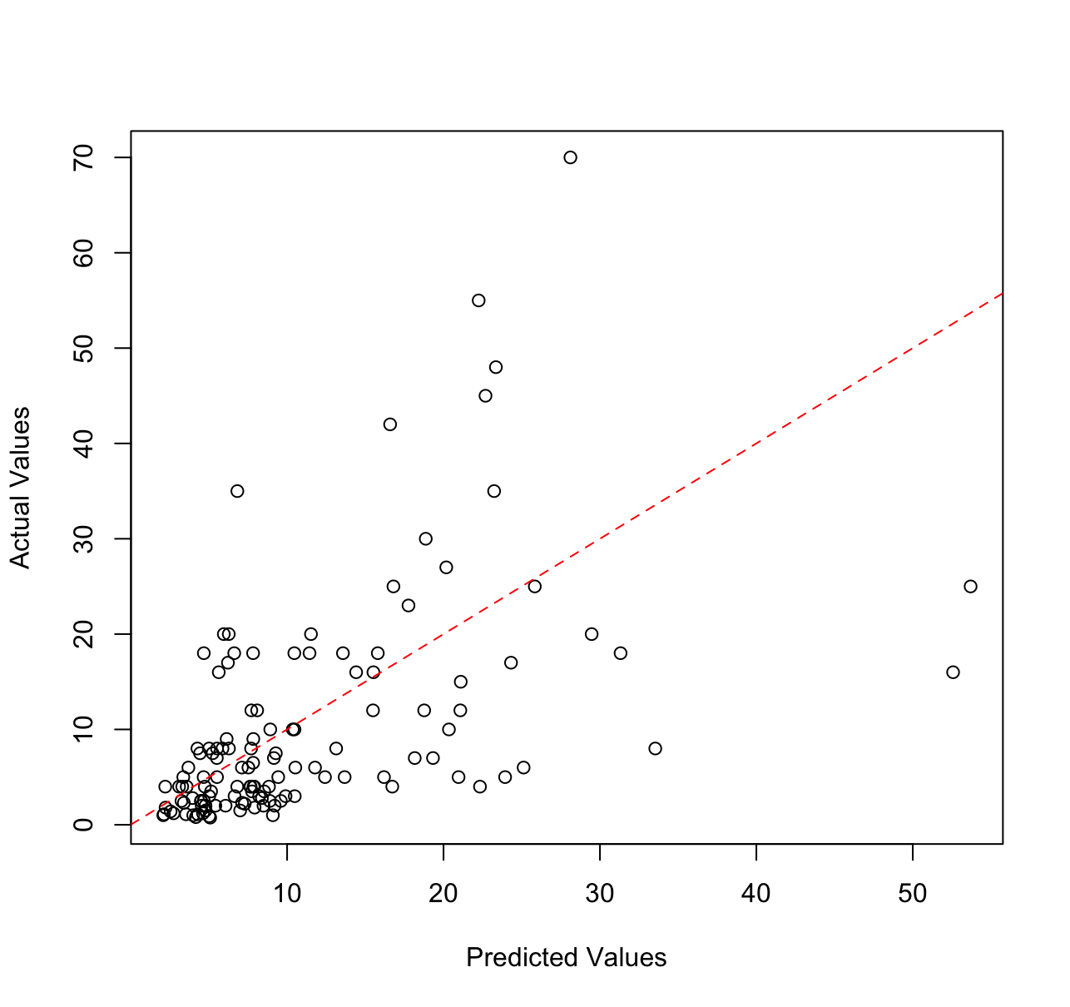
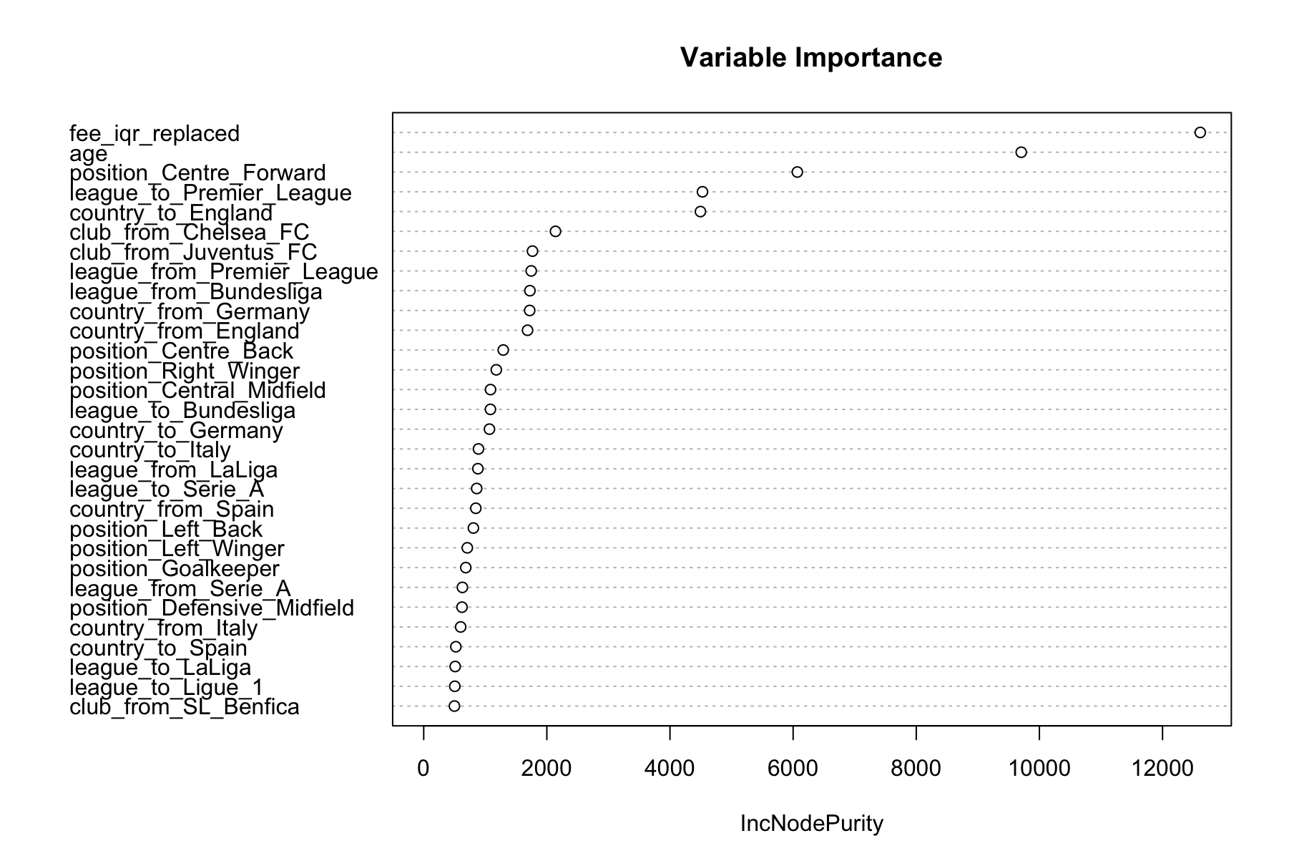
Predictions - Bagging
15
Actual Value vs Predicted Value Plot
Variable Importance for Bagging
1
OOS MSE
104.7355
2
OOS RMSE
10.23403
Parameters for Bagging: 2000 trees | 300 Max Nodes |

Slide 16
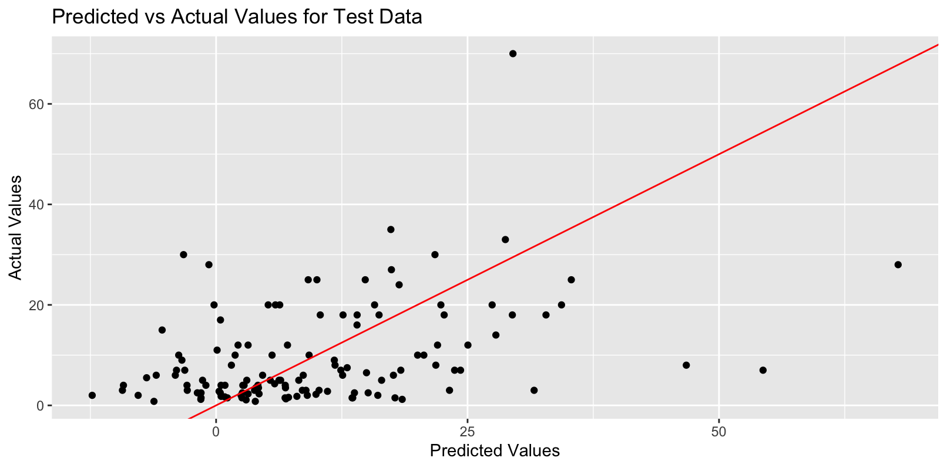
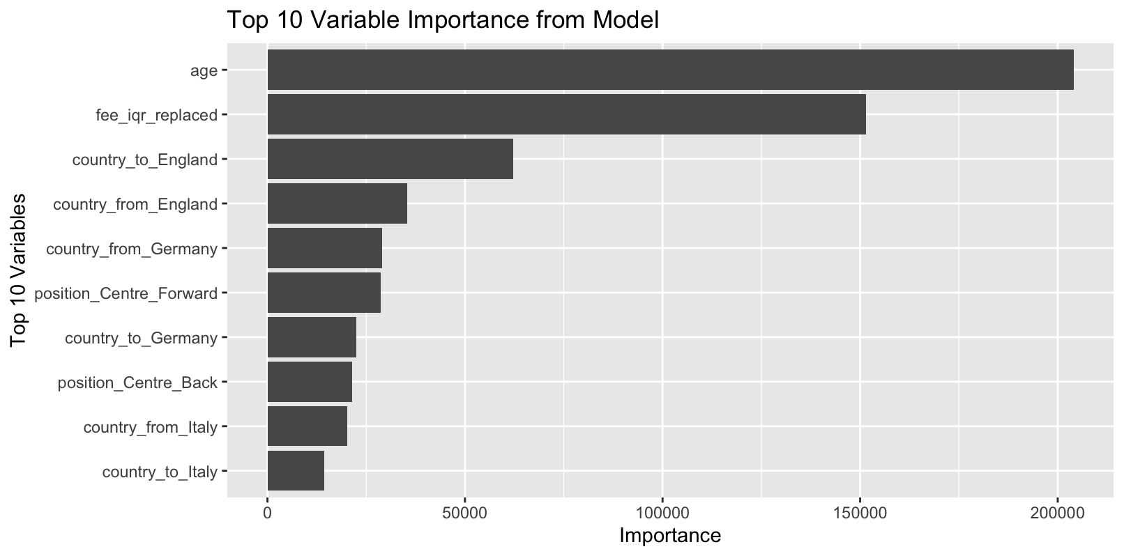
Predictions - Boosting
16
Actual Value vs Predicted Value
Variable Importance
1
OOS MSE
144.4287
2
OOS RMSE
12.0178519

Slide 17
Results and Conclusion
17
Algorithm | Test MSE | Test RMSE
KNN | 554.196 | 23.54137
Biggest Tree | 152.1856 | 12.33635
Pruned Tree before Cross Validation | 249.6649 | 15.80079
Pruned Tree after Cross Validation | 101.2218 | 10.06091
Bagging | 104.7355 | 10.23403
Random Forest | 102.6561 | 10.13193
Boosting | 144.4287 | 12.0178519

